Slide 1
Cluster analysis on day-ahead data 22nd February 2019
Researcher: Diarmid Roberts
Supervisors: Dr. Solomon Brown, Prof. Andy Cruden, Dr. Rachael Rothman
Sponsor: Drax Power Ltd.

Slide 2
Hypothesis
Price profile is product of discrete and continuous variables, e.g.:
Cluster analysis can be used to probe these, particularly the discrete variables.
Established work/leisure patterns
Gross demand profile
Day-ahead price
profile
Weather

Slide 3
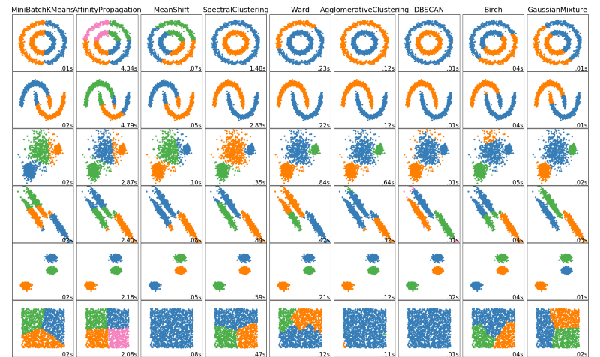
Cluster analysis
Group data points in clusters based on a distance criterion
Typically exemplified in 2D
Applies equally to our 24D situation!

Slide 4
Cluster analysis
Hierarchical clustering
Start with individual data-points
Define distance X
For each data-point, is there another point in range?
Combine points to cluster set
Define new distance X + Δ
For each data-point / cluster, is there another point/cluster in range
Combine points/clusters
Distance between clusters can be, say, average distance between constituent points (several methods to investigate)

Slide 5
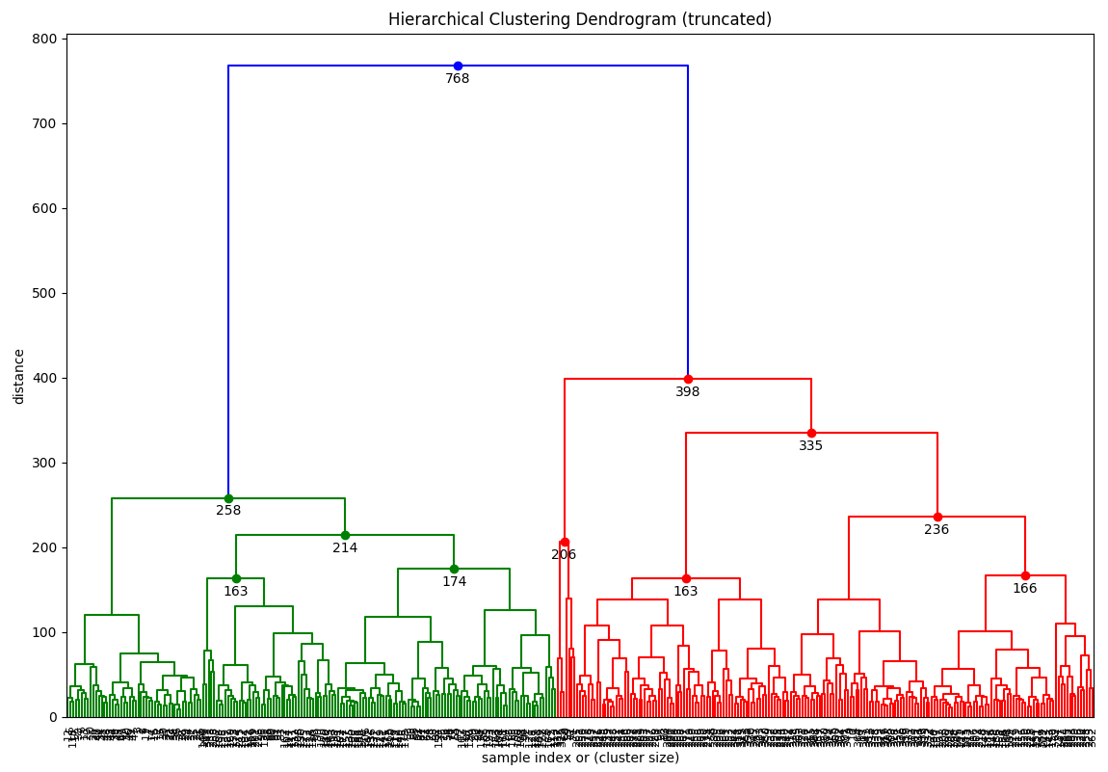
Example
Cluster analysis on cleaned 2018 day-ahead price data

Slide 6
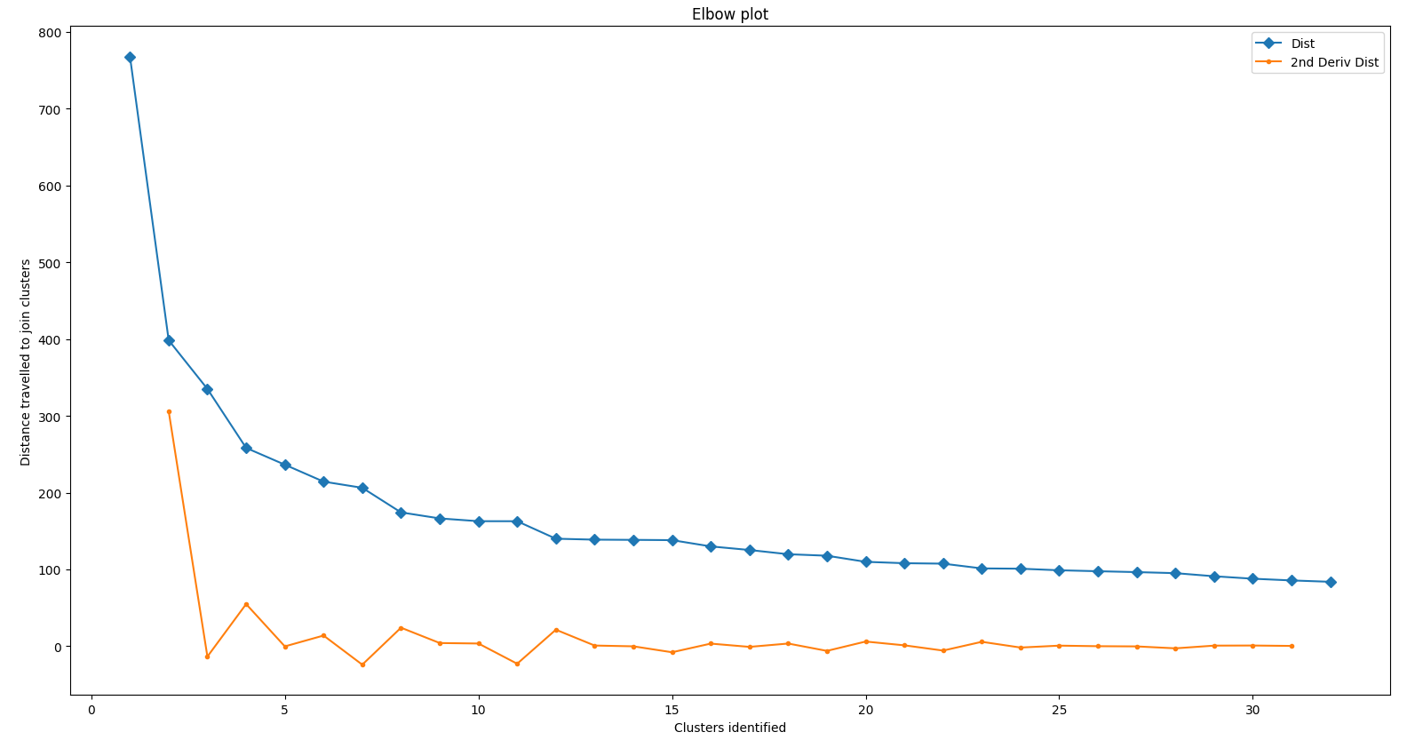
Example
Choice of cutoff distance is fairly subjective
Can be automated, e.g. elbow methods
But this doesn’t always work (https://joernhees.de/blog/2015/08/26/scipy-hierarchical-clustering-and-dendrogram-tutorial/)
n=2

Slide 7
My approach
Assign cut-off distance, retrieve cluster membership for each day, look for correlation with calendar.

Slide 8
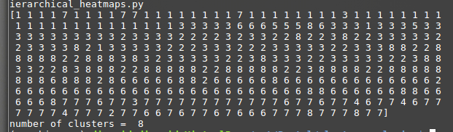
2 clusters

